Slide 1



DEPARTMENT OF ELECTRONICS AND COMMUNICATION ENGINEERING
AeroLinkers
Mr. S. Nithilan, IV-ECE
Ms. S. Monisa, II-ECE
Mr. T. P. Nishanth, II-ECE
K.S.RANGASAMY COLLEGE OF TECHNOLOGY
(Autonomous)
www.ksrct.ac.in
20.01.2026

Slide 2
Components Selection
MCU (STM32U375RG)
PMIC (nPM1300)
Wi-Fi Module (nRF7002)
Hardware Component Selection
Battery
(Li-Po 300mAh)
Audio Codec (SGTL5000)
IMU (LSM6DSOX)
Haptic Driver (DRV2603)
Display (1.69" IPS TFT) Capacitive Touch

Slide 3
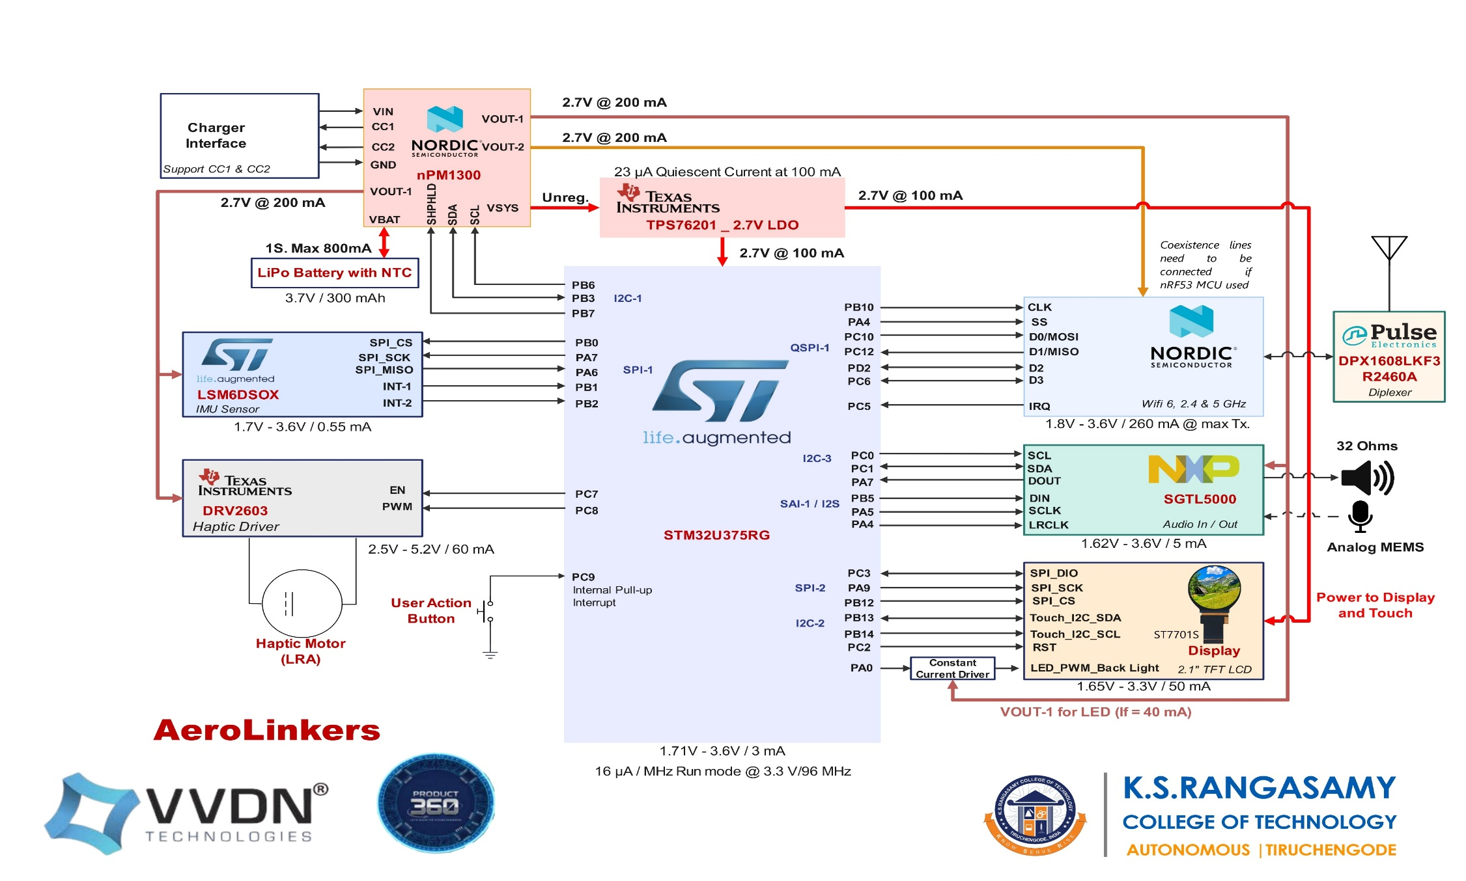

GPIO Mapping

Slide 4
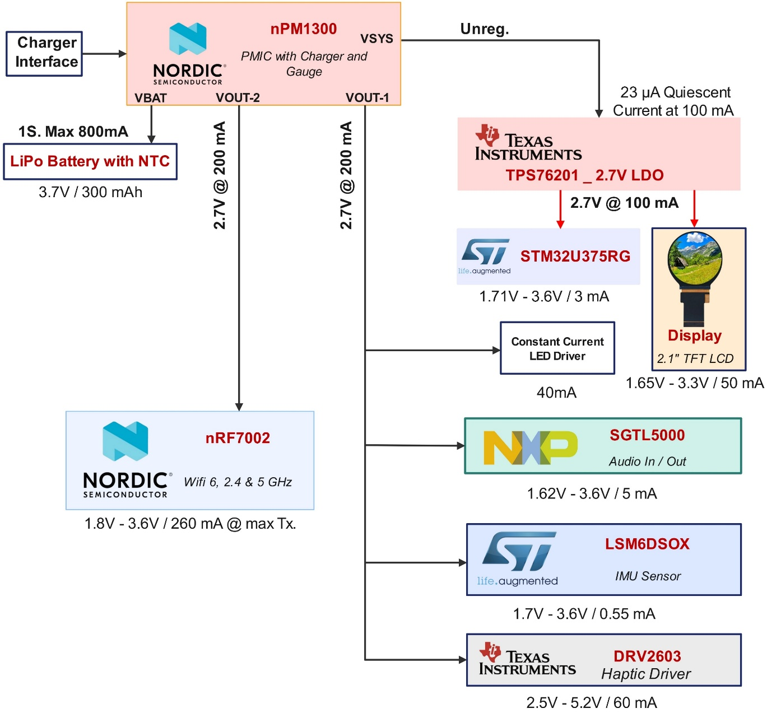
Power Architecture & Boot Sequence
Start
PMIC
VBAT & VIN -> VSYS
LDO
MCU and Display
MCU Enable Vout-1 in PMIC
Audio
Wi-Fi
MCU Enable Vout-2 in PMIC
IMU
Haptic

Slide 5
Power Consumption & Dissipation
All values are in Milliampere (mA)
​Operation (Approx. time) | PMIC & LDO​ | MCU​ | Wi-Fi | DISPLAY & Back Light (50% PWM)​ | IMU​ | AUDIO​ | HAPTIC (50% PWM)​ | TOTAL​
Boot​ing (5 Sec) | 0.823 ​ | 3​ | 180​ | 50​ | 0.55​ | 5​ | ​30 | 269.37​
Data Communication​ (1 Sec) | 0.823 ​ | 3​ | ​60 | 0​ | 0.55 | ​5 | 30​ | ​99.37
Rest ​Position​ | 0.823 ​ | ​3​ | ​60 | ​0 | 0.55 | ​0 | 0​ | ​94.37
Wake ​Position​ | 0.823 ​ | ​3​ | ​60 | 50​ | 0.55 | 0​ | ​0 | 114.37​
Docking​ | 0.823 ​ | ​3​ | ​60 | 0​ | 0.55 | ​0 | ​0 | 64.37​
Vibration​ (1 Sec) | 0.823 ​ | 3​ | 60​ | 50​ | 0.55​ | 0​ | 30​ | 144.37​

Slide 6
Reset Scheme and Interrupt Mapping
Applications can be reset by User Action Button
Peripherals can be reset by MCU through its interface
User Button -> High Priority _ Level-1
Touch -> Level-2
Wi-Fi -> Level-3

Slide 7
CPU Selection and Memory Requirement
Parameter | STM32U375RG | nRF5340 | CC3551E | STM32U5
MCU Type | ULP MCU | Radio-centric SoC | Wi-Fi MCU SoC | ULP MCU
Integrated Radio | None | BLE | Wi-Fi | None
Architecture Impact | Arm® Cortex®-M33 32-bit RISC core | Wireless SoC with two Arm® Cortex®-M33 | Arm® Cortex®-M33 | Arm® Cortex®-M33
Active Current | 16 µA/MHz | 55 µA | 48 µA | 16 µA
Deep Sleep Current | ~1.6 µA | 2.2 µA | 2.8 µA | 1.9 µA
Lead Time | 6–8 wks | 10–12 wks | 12–14 wks | 8–10 wks
Memory (ROM / RAM) | 1 MB (1024 KB) / 512 KB | 1 MB (1024 KB) / 512 KB | 1 MB (1024 KB) / 512 KB | 1 MB (1024 KB) / 512 KB

Slide 8
IDE, OS, CLI & Device Driver
Zephyr RTOS preferred – Low Footprint and Power Consumption
Linux not preferred – No need of much application and user interface
Device Driver for all selected components are available in Zephyr support page
For Command Line Interface, SSH preferred
WolfSSH library available for establishing SSH in Zephyr

Slide 9
Device Menu
MAIN DISPLAY
Information
(Home Page)
Language
Settings
Display
Settings
Sound & Haptic Settings
About Device
PNR / Booking Details
Device & Notification Language
Brightness
Volume
Device ID
Flight Status
Voice
Language
Text Size
Vibration
Version
Boarding Call Alerts
Always ON Display
Lounge Access, Location & availability (Extended Feature)

Slide 10
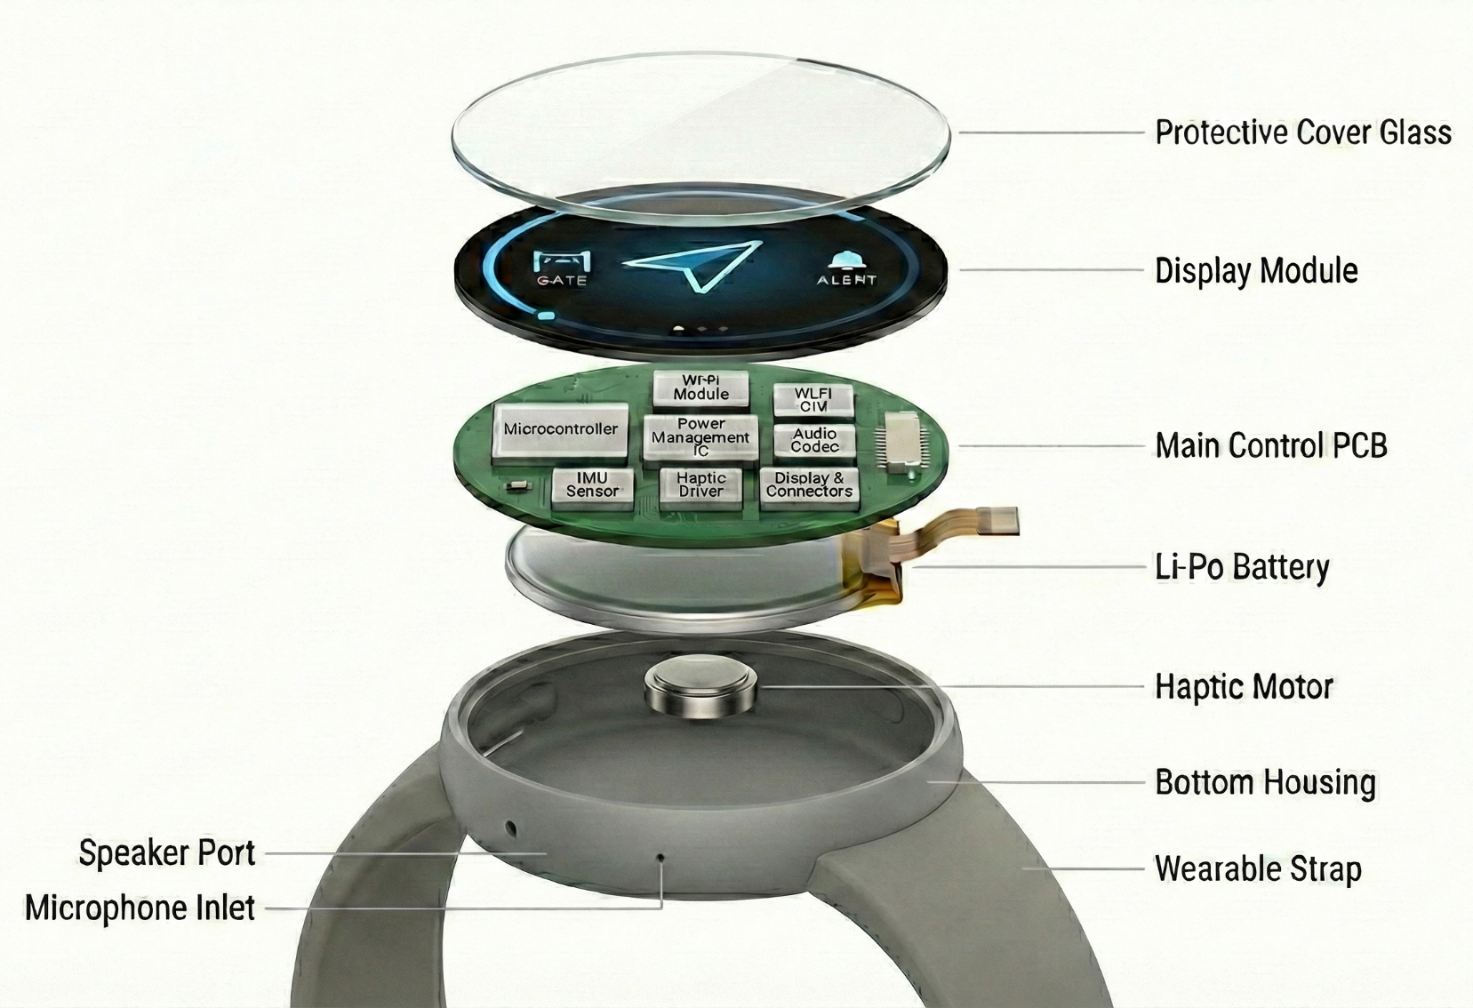
Exploded View

Slide 11
Thank You !

